Slide 1
DevOps setup

Slide 2
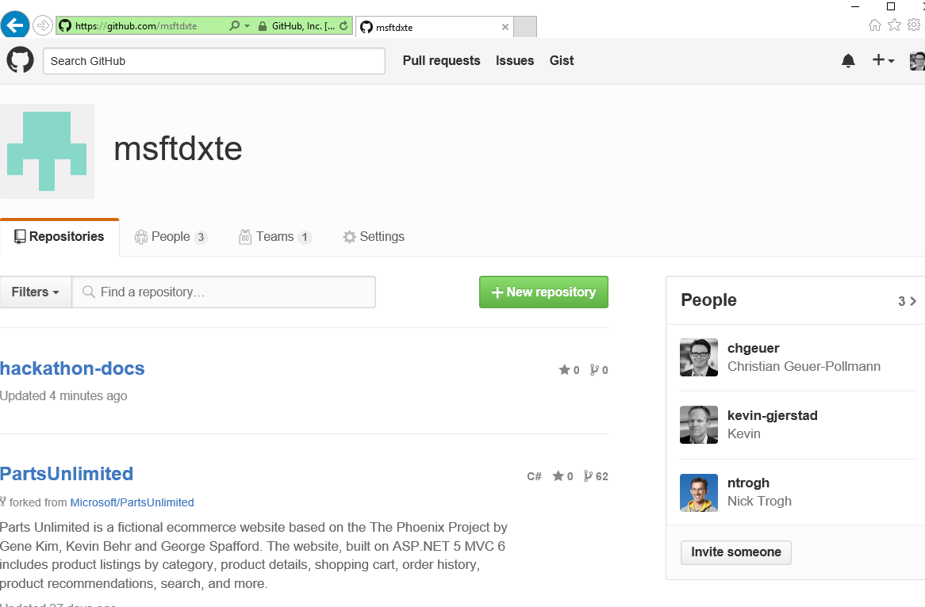
Created GitHub organization

Slide 3
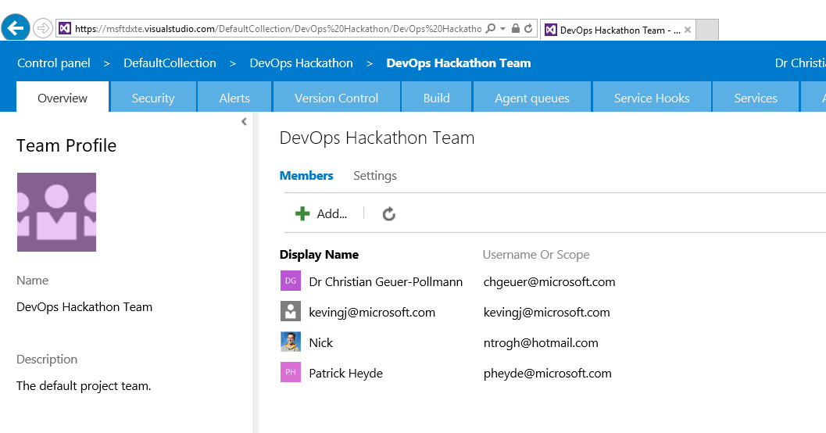
Created VSO Team

Slide 4
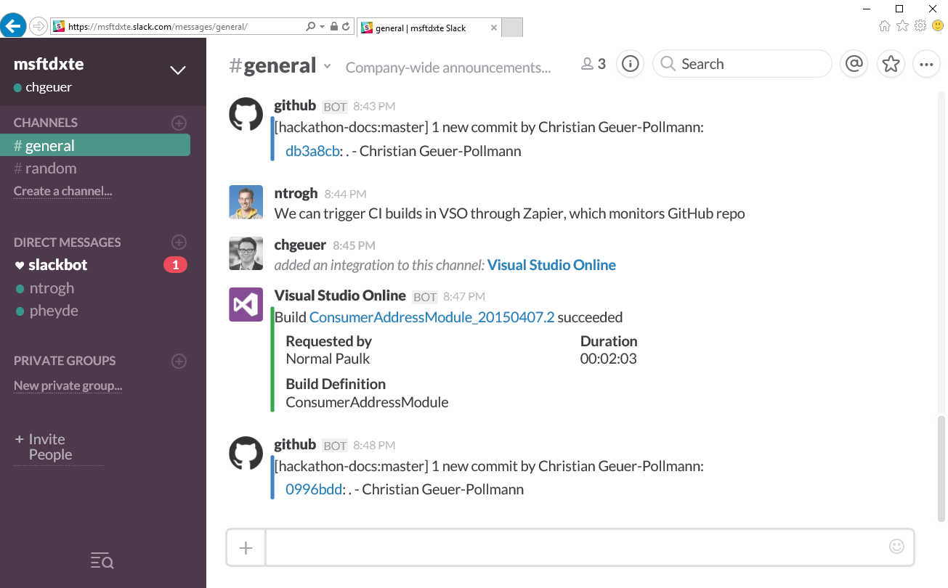
Created Slack site and hooked up 3rd party

